Slide 1
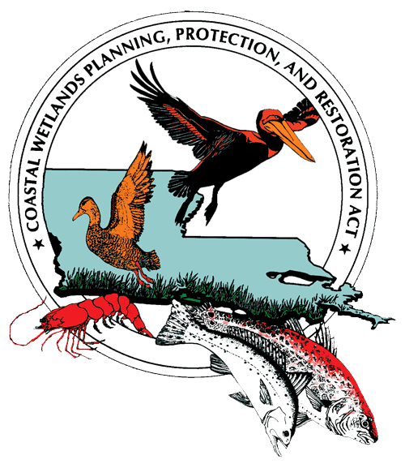
The Coastal Wetlands Planning, Protection and Restoration Act
Presentation for the
National Science Teachers Association Meeting
New Orleans, LA
November 10, 2011

Slide 2
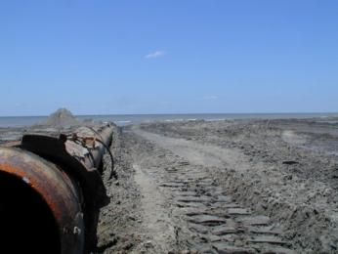
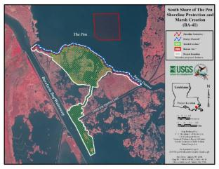
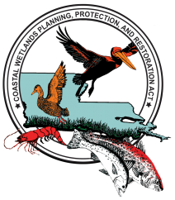
STEM, Louisiana Wetlands Restoration, and Student Success
Increasing the barrier shoreline width with dredged sediment.
CWPPRA Project BA-35
CWPPRA Project BA-41

Slide 3
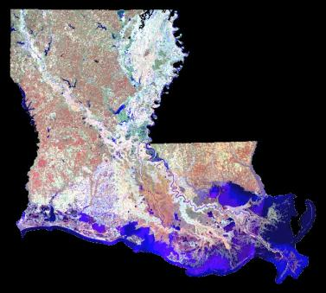
Where are you?

Slide 4
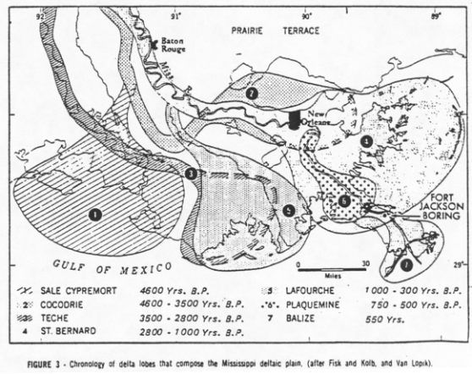
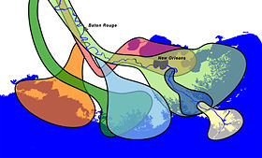
Louisiana was built by the Mississippi River over time.

Slide 5
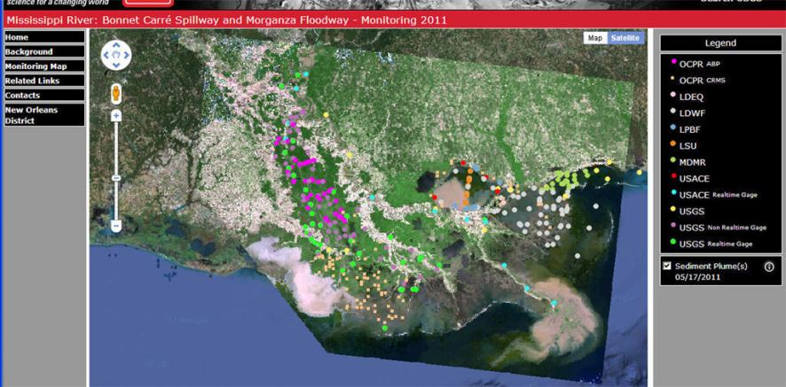
Sediment from the flood of 2011

Slide 6
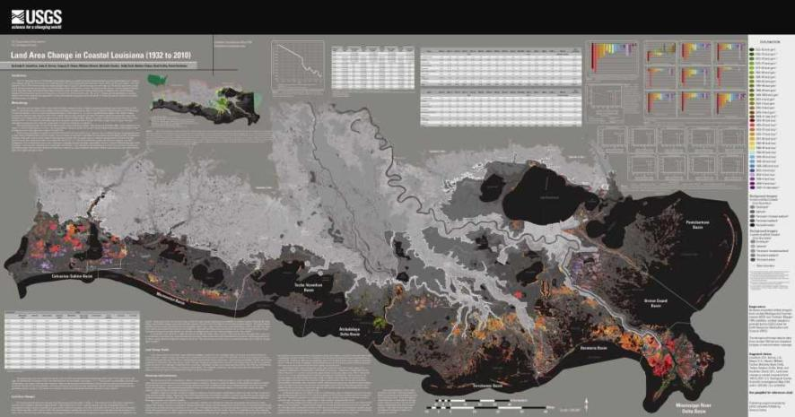
Land Area Change in Coastal Louisiana 1932 to 2010

Slide 7
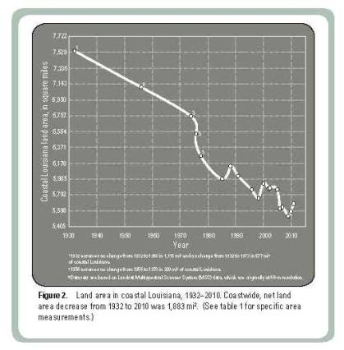
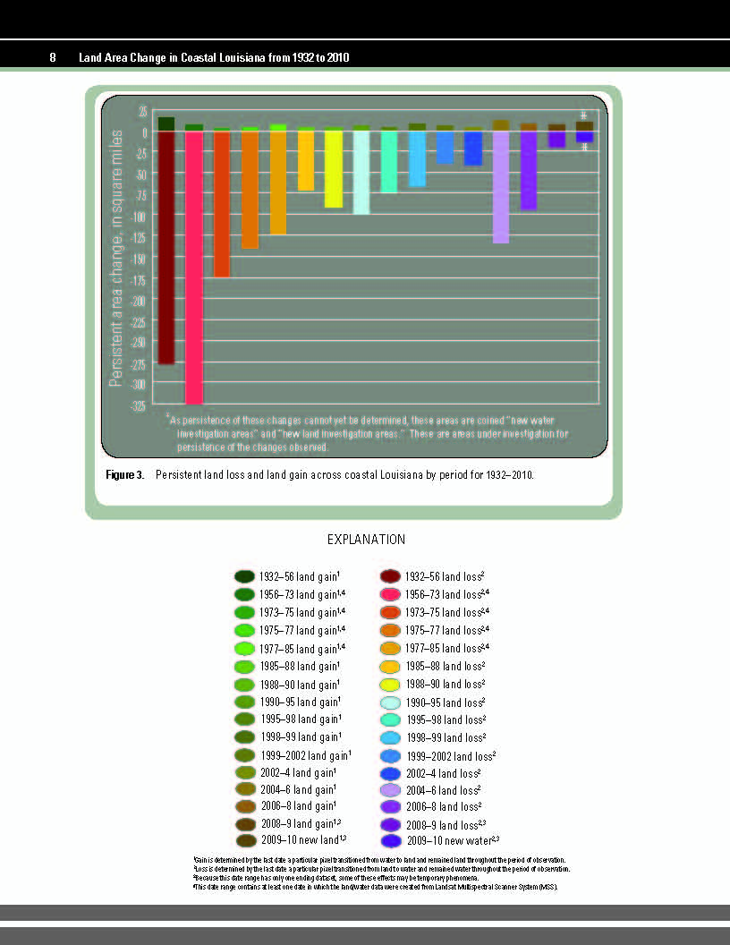
Land Change Map Data

Slide 8
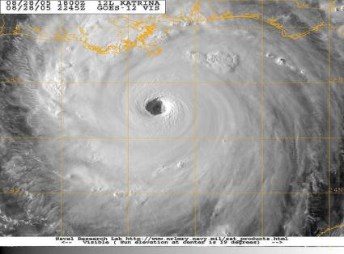
Natural Causes of Wetland Loss
Hurricanes
Subsidence
Wave erosion
Sea level rise
Notes:
Man is not the only cause of wetland loss. Hurricanes, subsidence, wave erosion and sea level rise are all natural causes of land loss in Louisiana.
Sea level rise is caused by global climate change. Natural and human forces change climate. Earth’s climate has been evolving for millions of years. (Long before man was even on Earth.) During warmer times shallow seas have covered most of the continents- a rise in sea level; during colder times fresh water has been trapped in glaciers and sea level fell.
Scientific evidence suggests that human activities such as the burning of fossil fuels and clearing of forests are also altering global climate. These activities are believed to be causing warming temperatures and global warming.

Slide 9
135 Years
Notes:
This is a map showing Isle Derniere in 1853 and in 1988. The maps were made 135 years apart.
This is also called Last Island, south of Houma in Terrebonne Bay.
At one time there was a wonderful hotel resort on Isle Derniere
Let’s look at the changes:
The most obvious is the loss of land.
Notice the change in the name of the area- Isle Derniere to Isles Derniere – The “s” has been added because it is no longer just one island.
Notice that each new island has been named.
How do you think the people of the area feel about the obvious land loss?
The question is what can be done help save these vanishing Louisiana wetlands.
Notice Raccoon Island; the small island on the far left of the lower map.

Slide 10
Process Alterations Made by Humans
River levees
Large Water Control Structures
Construction of Gulf Intracoastal Waterway
Ship Canal Construction
Access Canal Construction

Slide 11
Levees
Old River Control Structure
Construction of manmade waterways - GIWW
Notes:
Here is an aerial photo of the Mississippi River and the level which controls it from overflowing its banks. .
Notice how close the road is to the river.
What about homes? And businesses?
The desirable quality of the levee system is that it protects humans and their possessions. The detrimental side of the levee system is that it prevents sediment from returning to the marsh thus starving the wetlands of needed nutrients.
Can there be a balance?

Slide 12
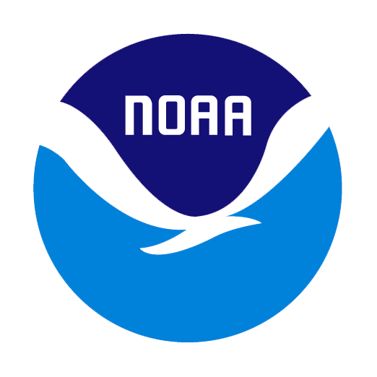
Coastal Wetlands Planning, Protection and Restoration Act
U.S. Department of Commerce – NOAA, National Marine Fisheries Service
U.S. Department of Interior -
U.S. Fish and Wildlife Service
U.S. Department of Agriculture - Natural Resources Conservation Service
U.S. Department of the Army - U.S. Army Corps of Engineers
U.S. Environmental Protection Agency
Louisiana Governor’s Office
Notes:
When it was first enacted, CWPPRA received about 30 million a year, now we receive around 80 million.
CWPPRA Process: 1.) Each year 4 regional planning teams meet to accept projects nominated by the public or various civic or nonprofit organizations. 2.) Then, a coast-wide planning selects up to 20 projects and 6 demonstration projects from the nominated list. 3.) 10 candidate projects and 3 demonstration projects are selected for more detailed assessments. They evaluate things like cost, need, feasibility and the overall benefit of the project. 4.) The technical committee then conducts public hearings to release findings and receive comments. 5.) The technical committee then recommends up to four projects to receive funding. 6.) The task force selects projects to receive funding.

Slide 13
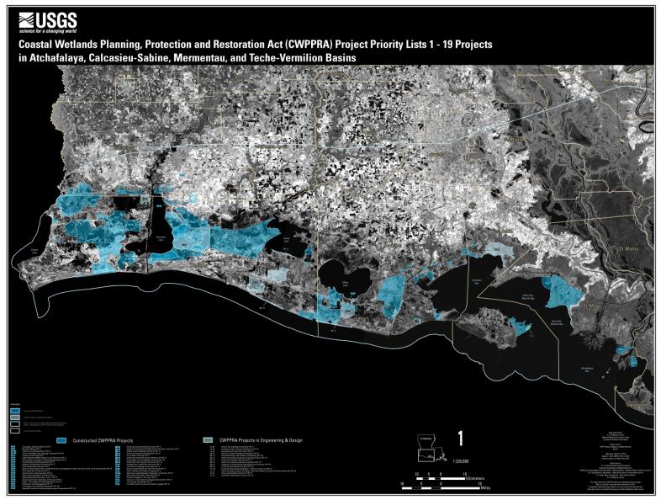

Slide 14
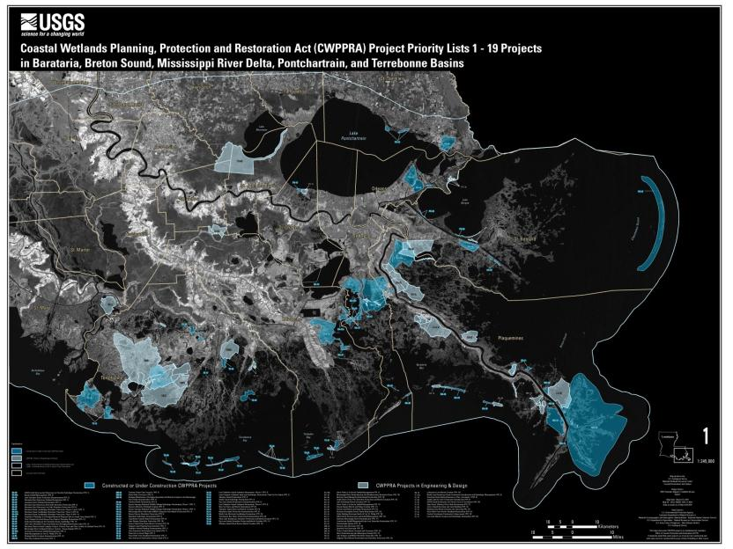

Slide 15
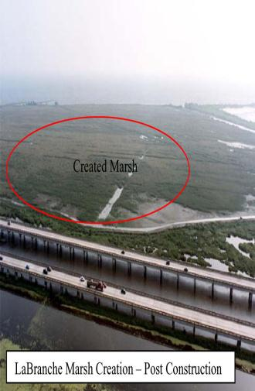
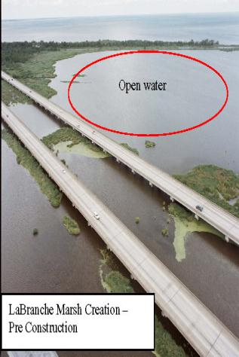
Bayou LaBranche Wetlands – One of the First CWPPRA Projects I-10 Near New Orleans

Slide 16
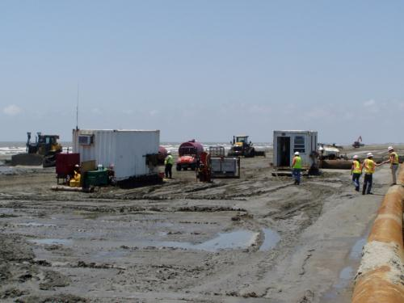
Pass Chaland to Grand Bayou Pass Barrier Shoreline Restoration
BA -35
Increasing the barrier shoreline width with dredged sediment.

Slide 17
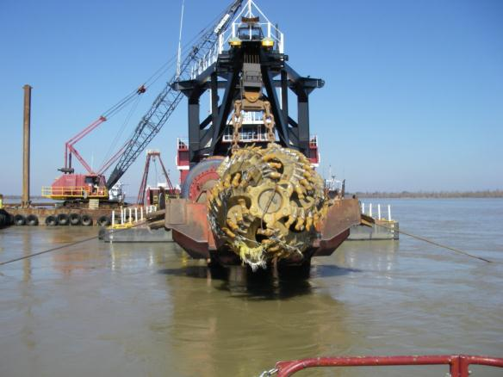
Mississippi River Sediment Delivery System-Bayou Dupont
BA-39
Cutterhead dredge

Slide 18
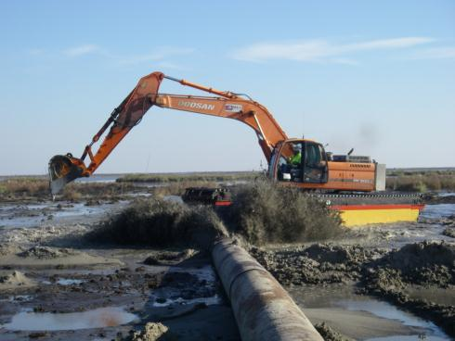
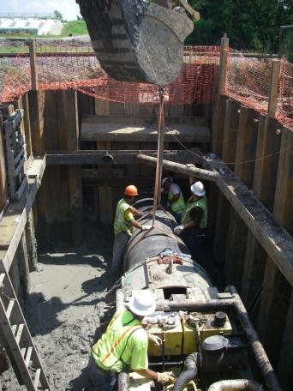
Mississippi River Sediment Delivery System-Bayou Dupont
BA-39
Pipe jack and bored under the road and railroad to deliver sediment to a marsh receiving area in Plaquemines Parish near the ConocoPhillips plant.

Slide 19
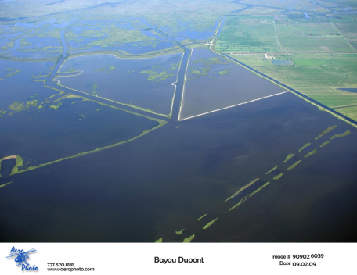
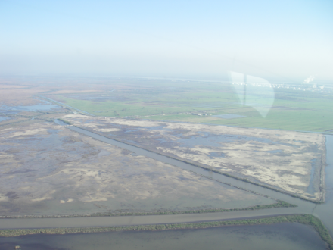
Mississippi River Sediment Delivery System-Bayou Dupont
After
Before
BA-39

Slide 20
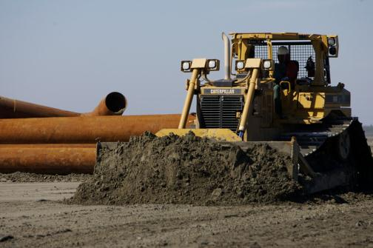
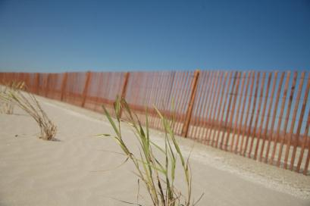
Barataria Barrier Island Complex Project: Pelican Island to Pass La Mer to Chaland Pass Restoration
BA-35
Installation of sand fencing was concurrent with dune construction.

Slide 21
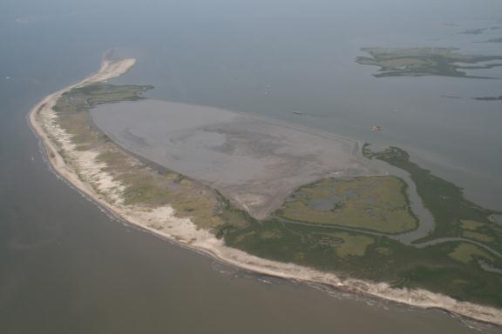
Whiskey Island Back Barrier Marsh Creation
TE-50
Approximately 316 acres of back barrier
intertidal marsh habitat, 5,800 linear feet of tidal creeks, three 1-acre tidal ponds, and 13,000 linear feet of protective sand dune were created by semi-confined disposal and placement of dredged material.
Project
Area

Slide 22
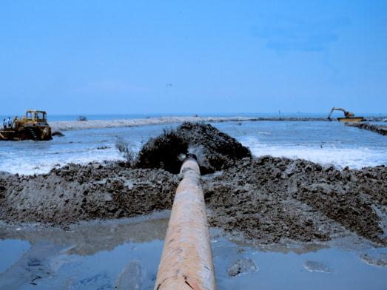
East Timbalier Island Sediment Restoration (TE-25)
Almost three million cubic yards of sediment were utilized to establish a 200-foot wide dune and a 600-foot wide marsh along the length of the island.
This created 170 acres of intertidal marsh and is helping to protect thousands of acres of existing fringing marsh to the north.
To further stabilize the dredged sediments, 13,000 feet of sand fences and approximately 20,000 plugs of marsh grasses were added.
Notes:
East Timberlier Project - LaFourche Parish, Louisiana -Almost three million cubic yards of sediment were utilized to establish a 200-foot wide dune and a 600-foot wide marsh along the length of the island. This created 170 acres of intertidal marsh and is helping to protect thousands of acres of existing fringing marsh to the north. To further stabilize the dredged sediments, 13,000 feet of sand fences and approximately 20,000 plugs of marsh grasses were added in May 2000 and June 2001 respectively.

Slide 23
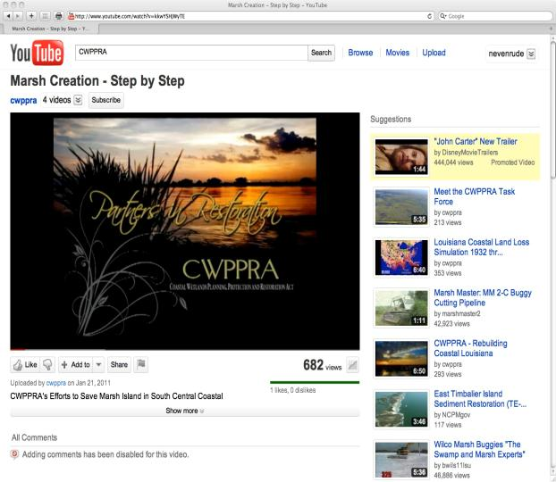
Marsh Creation Step by Step TV-21

Slide 24
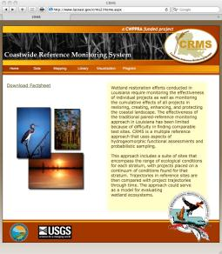
Coastwide Reference Monitoring System (CRMS)
www.LACoast.gov/crms_viewer
Click on Mapping
Choose Basic Viewer

Slide 25
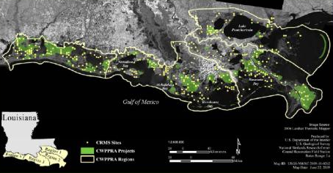
CRMS and CWPPRA
Map- GIS Data
Graphs
Surface Elevation or Accretion
% Organic Soil or Bulk Density
Vegetation Types
Forested Areas
Water Information
Precipitation
Report Card

Slide 26
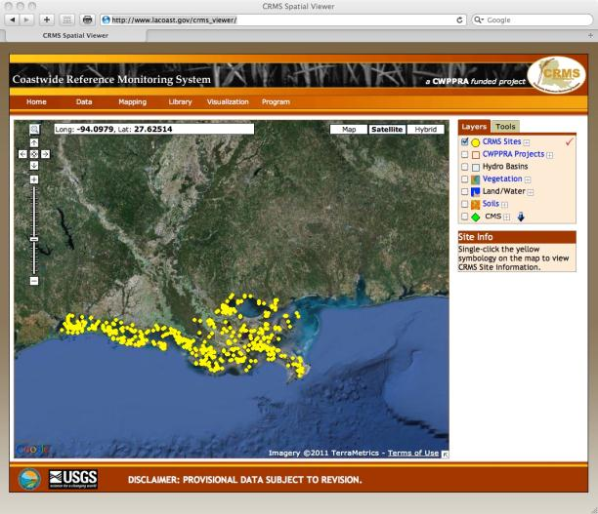
http://www.LACoast.gov/crms_viewer

Slide 27
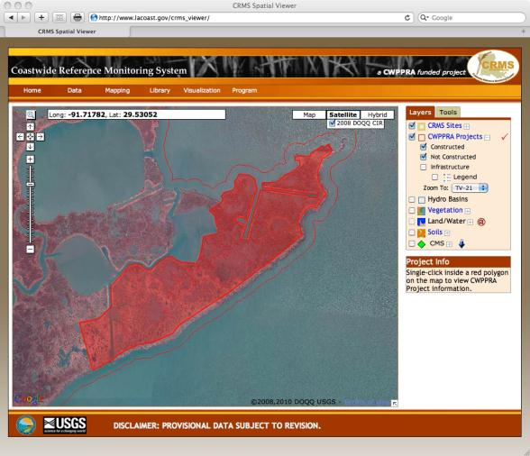
TV-21 East Marsh Island

Slide 28
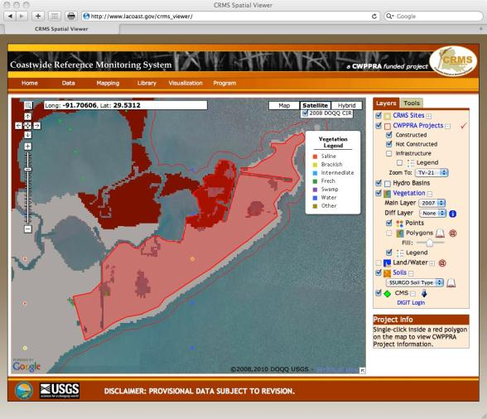
All Layers Highlighted

Slide 29
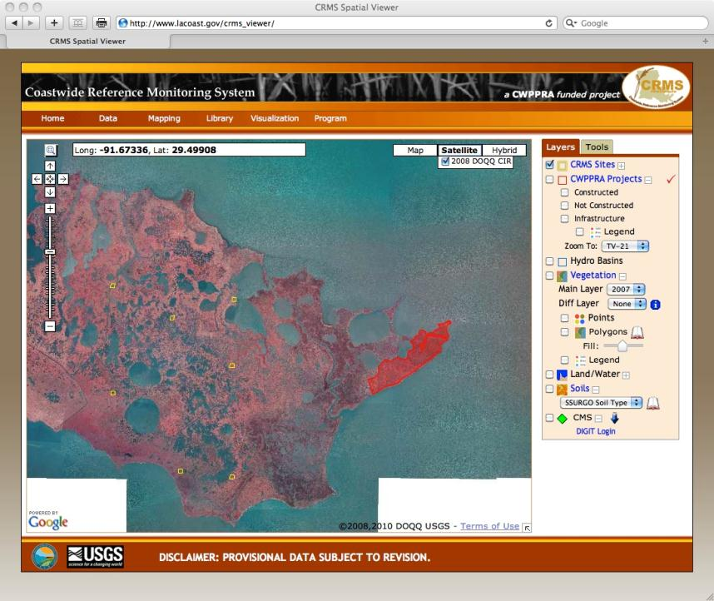

Slide 30
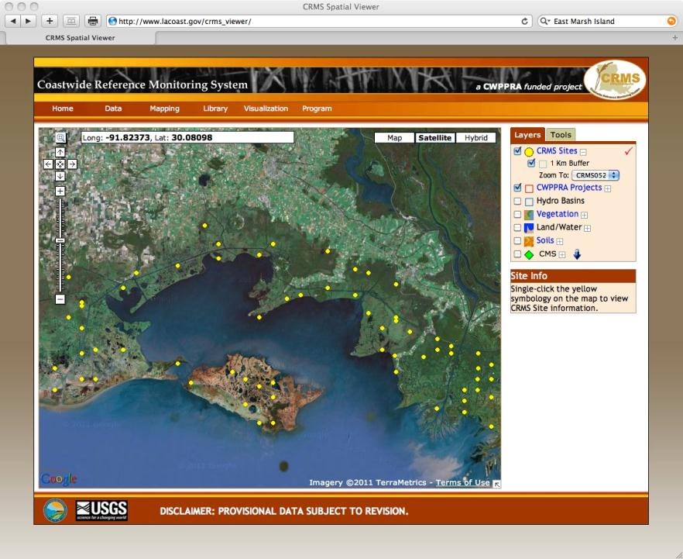
1
2
Pick CRMS0523
3
SINGLE CLICK

Slide 31
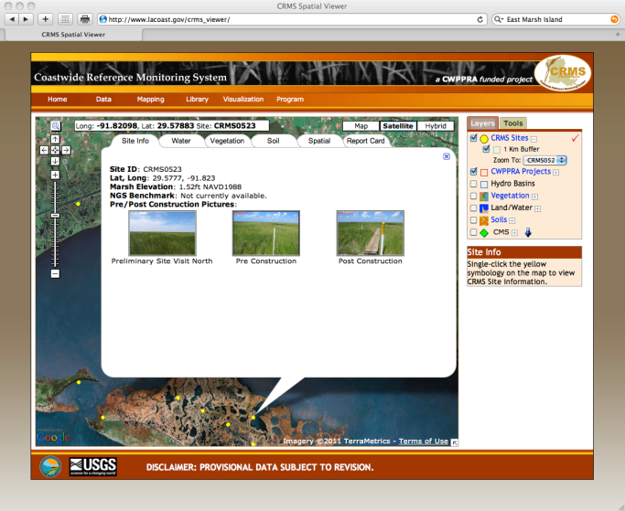
CRMS Site 0523
SINGLE CLICK

Slide 32
Navigating the Site
Single Click to get a fly out box with information.
Most frequent mistake – double click
Notice the tabs at the top of the fly out.
Each tab contains bits of information for each CRMS site
You can choose Map, Satellite, or Hybrid

Slide 33
Water Data
To make every teacher happy!

Slide 34
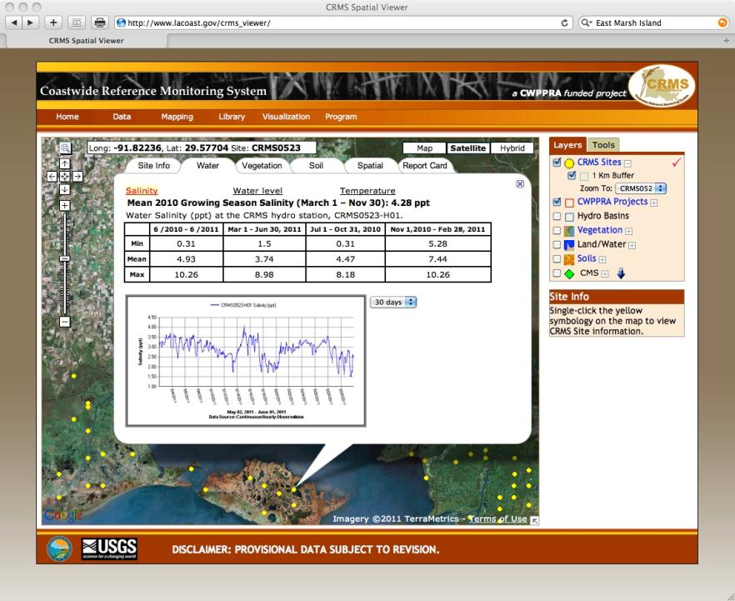

Slide 35
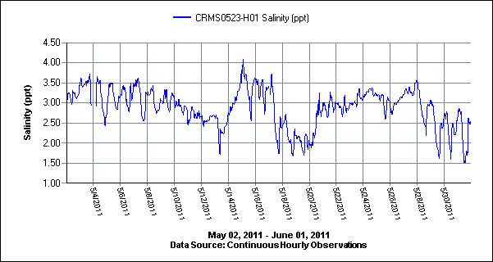
Salinity Over 30 Day Period

Slide 36
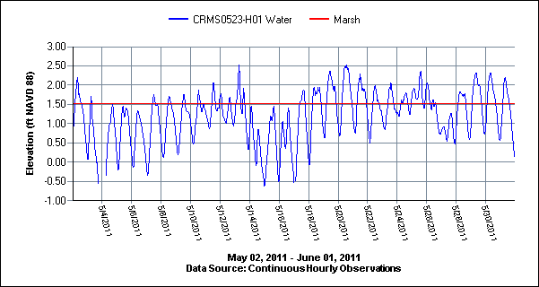
Water Levels

Slide 37
Actual Data

Slide 38
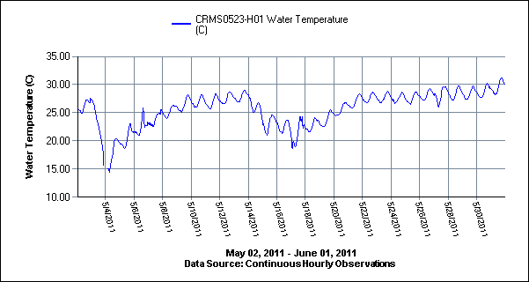
Water Temperature

Slide 39
Vegetation Data
More good stuff

Slide 40
Vegetation Data

Slide 41
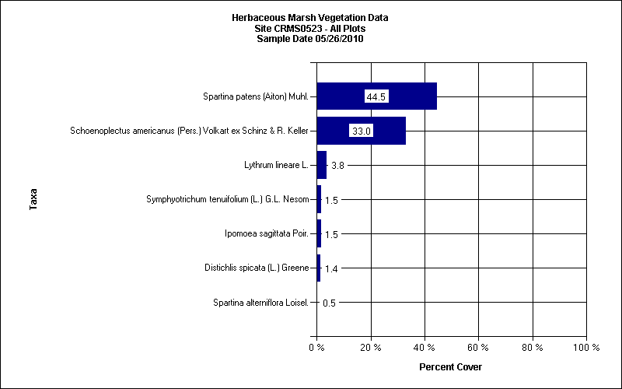

Slide 42
Soil Data
Cool Graphs for Students to Use as Learning Tools

Slide 43
Soil Data Sheet

Slide 44
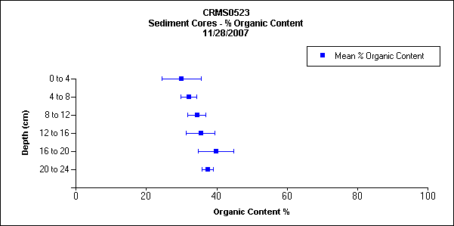

Slide 45
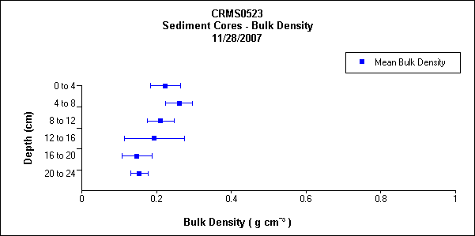

Slide 46
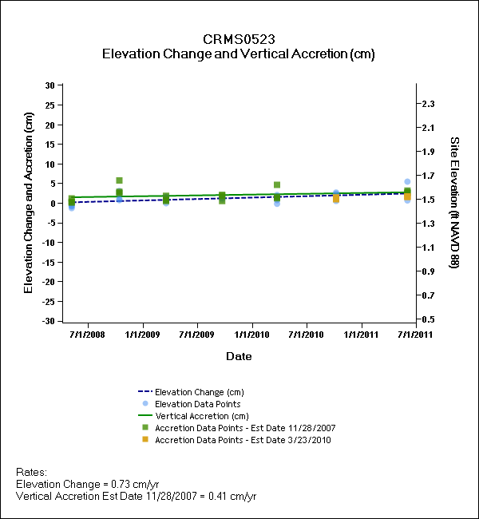

Slide 47
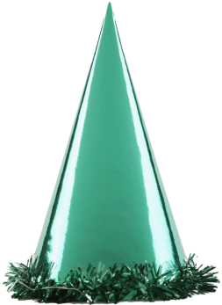
Spatial Data
Data that defines a location

Slide 49
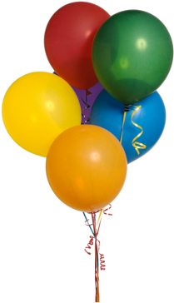
Graphs? But Wait -
There is more!

Slide 50
Visualization= Graphs

Slide 51
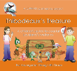
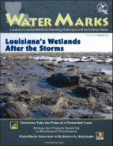
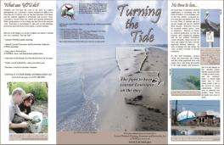
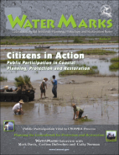
How can you help spread the word?

Slide 52
Susan Testroet-Bergeron
BergeronS@USGS.gov
337-266-8623

